Slide 1

Functions
DATA ANALYTICS BOOTCAMP | IRONHACK

Slide 2



User defined functions
Because sometimes we are repeating over and over chunks of code in which only changes a few set of things or variables.
We write the piece of code once allowing the part which changes to change.
We can ‘isolate’ pieces of code.
Splits the main program in ‘parts’
Easier to debug.
Why?
00

Slide 3
def function_name( argument1,...):
‘’’
Document your function!
Arguments, type of arguments
Output, output type
Purpose of the function
‘’’
….
….
return variable
The arguments of a function can be of any type.
A function can contain ‘optional’ arguments, which are ‘internal’ variables that take a ‘default’ value unless another is specified in the call.
The return clause is optional but it allows to capture as many values as desired ( separated by comma )
User defined functions
Syntax
00

Slide 4
def function_name( x, y ):
‘’’
Document your function!
Arguments, type of arguments
Output, output type
Purpose of the function
‘’’
….
….
return x-y
function_name(5, 6)
outputs = -1
function_name(6, 5)
outputs = 1
Function arguments are assigned “slot by slot”
Function arguments are LOCAL
User defined functions
Function slots
00

Slide 5
def function_name( x, y, z = 0, t = 1 ):
‘’’
Document your function!
Arguments, type of arguments
Output, output type
Purpose of the function
‘’’
if ( z == 0 ):
return x - y
else:
return x - y + z
function_name(5, 6)
outputs = -1
function_name(5, 6, z = 3)
outputs = 2
Function optional arguments take the ‘default’ value unless they are provided during the call
User defined functions
Function optional arguments
00

Slide 6
User defined functions
As simple as using the funtion_name with the corresponding arguments.
function_name()
Calling a user defined function
00

Slide 7
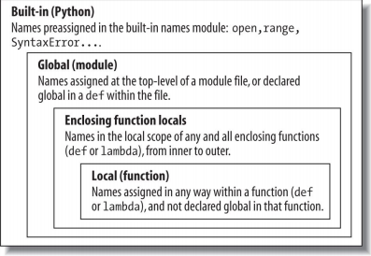
User defined functions
Global: can be seen by any function
Local: they only live inside the function (even though they can have the same name as another variable outside of the function.
Variable scope
00

Slide 8


